Slide 1
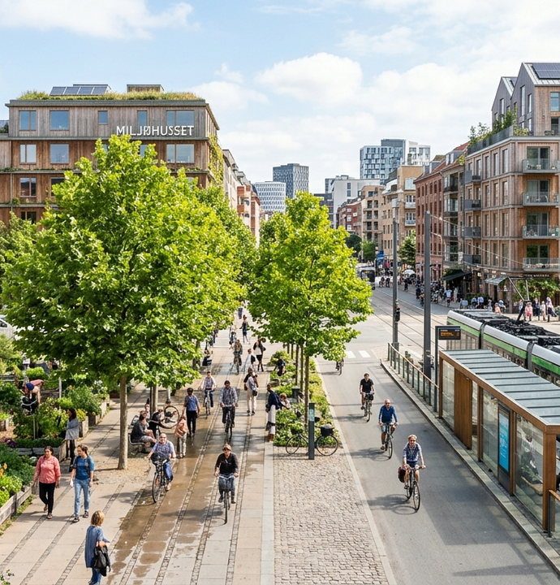
IDEAFORGE 26
Fix My City
When several residents report one broken streetlight, the crew should get one repair ticket.
Civic reporting for Tamil Nadu
Notes:
Open with the streetlight example. A resident can report in their own words and still share a repair record with a neighbor who described the same fault differently.
Project sources: Project README and project hero artwork.

Slide 2


PROBLEM AND SOLUTION
02 / 07
Two reports can describe one repair
“The lamp by the bus stop keeps blinking.”
01
“It goes dark at the crossing near the bus shelter.”
department ticket
The second resident can join the open case. The electrician sees the attached count, and both residents can track the repair.
Example reports about the same lamp
Notes:
These are illustrative reports. Ask what happens if the two pins are near different poles. Location narrows the search, and the model compares the described asset and fault before suggesting a match.
Project sources: src/pages/ComplaintFormPage.tsx, src/components/DepartmentDashboard.tsx, supabase/attached-complaint-count.sql. Icons from lucide.dev.

Slide 3
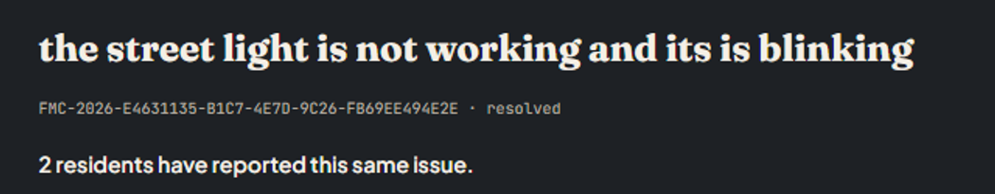
PRODUCT WORKFLOW
03 / 07
How a complaint reaches the crew
01
Describe the fault
Pin the location. If the text is a greeting or random letters, the form asks what needs fixing.
02
Review the AI assessment
Gemini assigns a priority and checks nearby open complaints. A separate-ticket request gets a second check.
Department inbox
The ticket shown here records two residents reporting the same blinking light.
03
Follow the repair
The department acknowledges the case, starts work and records a resolution note for linked residents.
Notes:
Show the real department screenshot. The three stages describe the local implementation. The newest relevance and duplicate checks require the corresponding Supabase functions and SQL migrations to be deployed.
Project sources: User-provided department dashboard screenshot, src/pages/ComplaintFormPage.tsx, supabase/functions/assess-draft/index.ts, supabase/functions/find-duplicate-reports/index.ts.

Slide 4
SYSTEM ARCHITECTURE
04 / 07
Where each decision happens
Supabase Auth
Account sessions
React web app
Citizen and worker views
Edge Functions
Check and score drafts
Gemini API
Structured assessment
PostgreSQL
Reports and updates
Vercel serves the frontend. Leaflet displays OpenStreetMap tiles, and Nominatim provides location search.
Notes:
React holds the interface. The browser signs in through Supabase Auth and accesses permitted records under database policies. Edge Functions verify the user token and call Gemini with a server-side secret. SQL functions route categories to departments, link duplicate reports and record notifications. Workers update status through a database function.
Project sources: src/App.tsx, src/services/auth.ts, src/services/location.ts, supabase/department-workflow.sql and supabase/functions/.

Slide 5










SOFTWARE
05 / 07
Technology behind the prototype
Frontend and maps
React
TypeScript
Vite
Tailwind CSS
Leaflet
Citizen and worker views
Typed report data
Frontend build
Interface styling
Interactive maps
Backend and hosting
Supabase
PostgreSQL
Deno
Gemini
Vercel
Auth and API access
Tickets and permissions
Edge Function runtime
Relevance and matching
Web hosting
Notes:
Python is not part of the application stack. Its backend is Supabase, with PostgreSQL procedures and TypeScript Edge Functions running on Deno. Leaflet is the map library, OpenStreetMap provides tiles and Nominatim supplies geocoding.
Project sources: package.json, vite.config.ts, vercel.json and Supabase function code. Logos: https://github.com/devicons/devicon ; https://github.com/lobehub/lobe-icons ; Leaflet package src/images/logo.svg.

Slide 6



FEASIBILITY AND VIABILITY
06 / 07
A pilot one ward can operate
Technical feasibility
Start with streetlights in one ward. Limit AI comparisons to open complaints in the same category and department within 350 metres.
Who runs it
The ward office assigns a lighting team to the inbox. A named supervisor reviews disputed matches and follows up on ageing tickets.
Operating costs
Track AI calls per complaint, photo storage and staff review time. Compare the cost per resolved case with the ward’s current process.
Pilot prerequisite: deploy the latest database migrations and AI functions, then rehearse with citizen and worker accounts.
Notes:
The ward pilot and supervisor review are proposals. There are no measured savings, pilot customers or revenue claims. Before expansion, manually sample linked tickets for false matches, including two neighboring poles with similar descriptions. Confirm that operating costs and staff effort justify a second ward.
Project sources: README.md, supabase/functions/find-duplicate-reports/index.ts, supabase/duplicate-report-workflow.sql.

Slide 7
07 / 07 LIVE DEMONSTRATION
One repair, seen by both residents
1
2
3
Resident A
Resident B
Electrician
Report a blinking streetlight and pin its location.
Describe the same lamp in different words. Join the suggested case.
Open the shared ticket, start work and add a resolution note.
Success on screen: one department ticket, one attached report, and the same repair history for both residents.
Notes:
Rehearse with two citizen accounts and a department account. Use an open issue and a matching location. Close by showing the same ticket reference from both citizen accounts. Measure time to acknowledgement and the share of AI matches accepted during a ward pilot. Demo outcome is a target, not a measured result. Repository: https://github.com/moneeshwaran184-rgb/IDEAFORGE26 .
Project sources:

